Slide 1
Create your first canvas app in Power Apps

Slide 2


Speakers
Andriana Vera
Beta Microsoft Learn Student Ambassador
Athens
Christina Pardali
Beta Microsoft Learn Student Ambassador
Thessaloniki

Slide 3
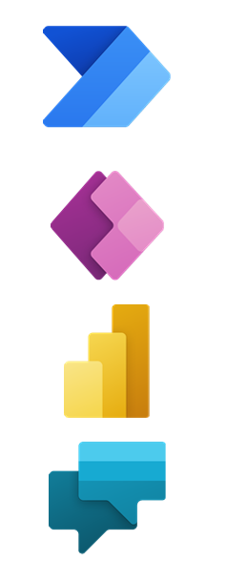
Agenda
Introduction to Power Platform
Get started with Power Apps
Customize a canvas app in Power Apps
Manage apps in Power Apps

Slide 4

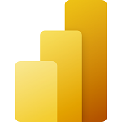


Power Platform consists of the following 4 key products:
Power Apps
Power BI
Power Automate
Power Virtual Agents

Slide 5
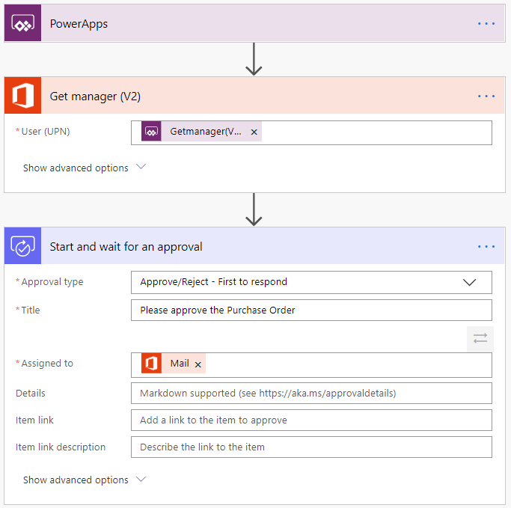
Power Automate

Slide 6
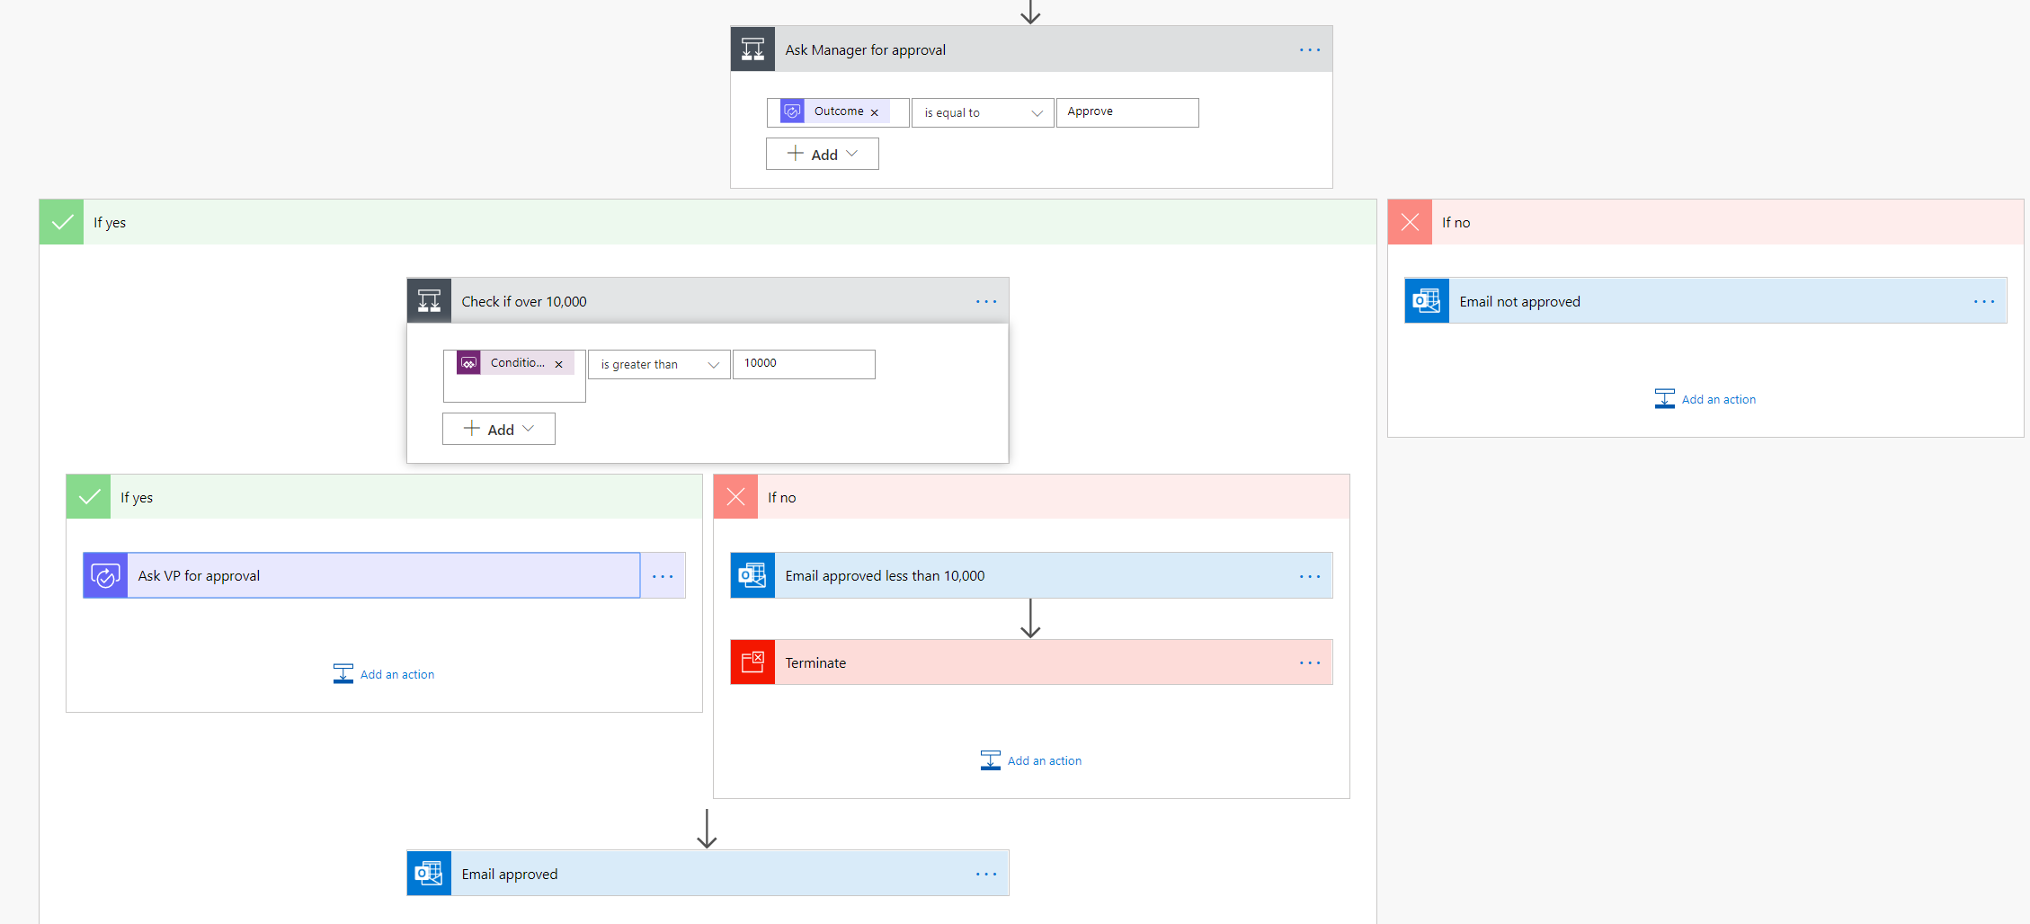
Power Automate

Slide 7
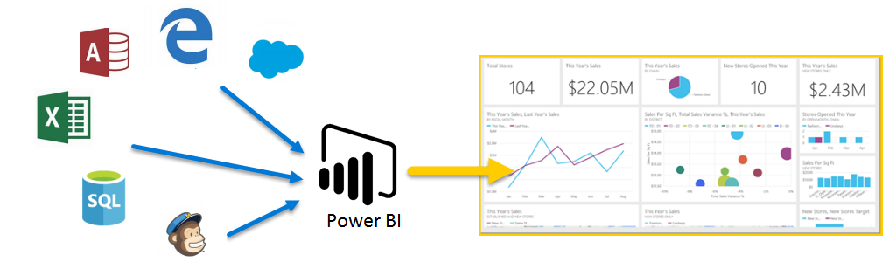
Power BI

Slide 8
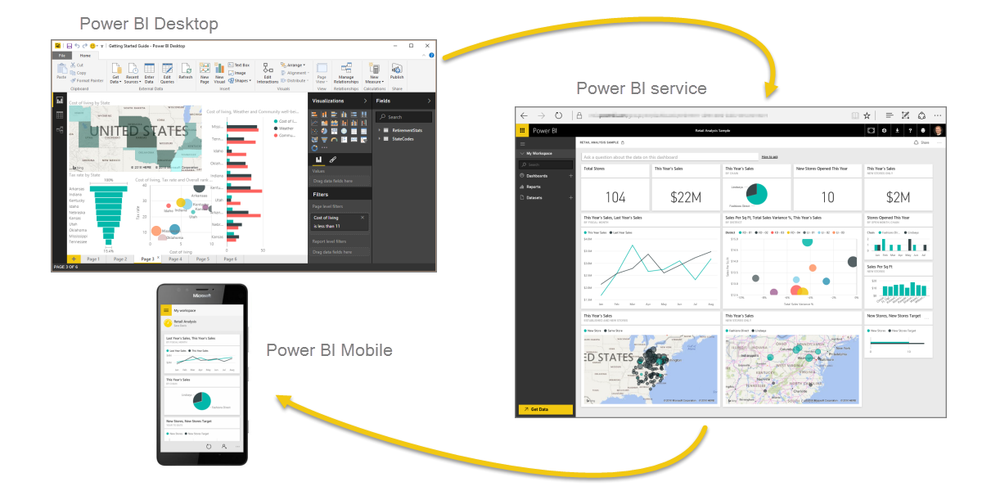
Power BI

Slide 9
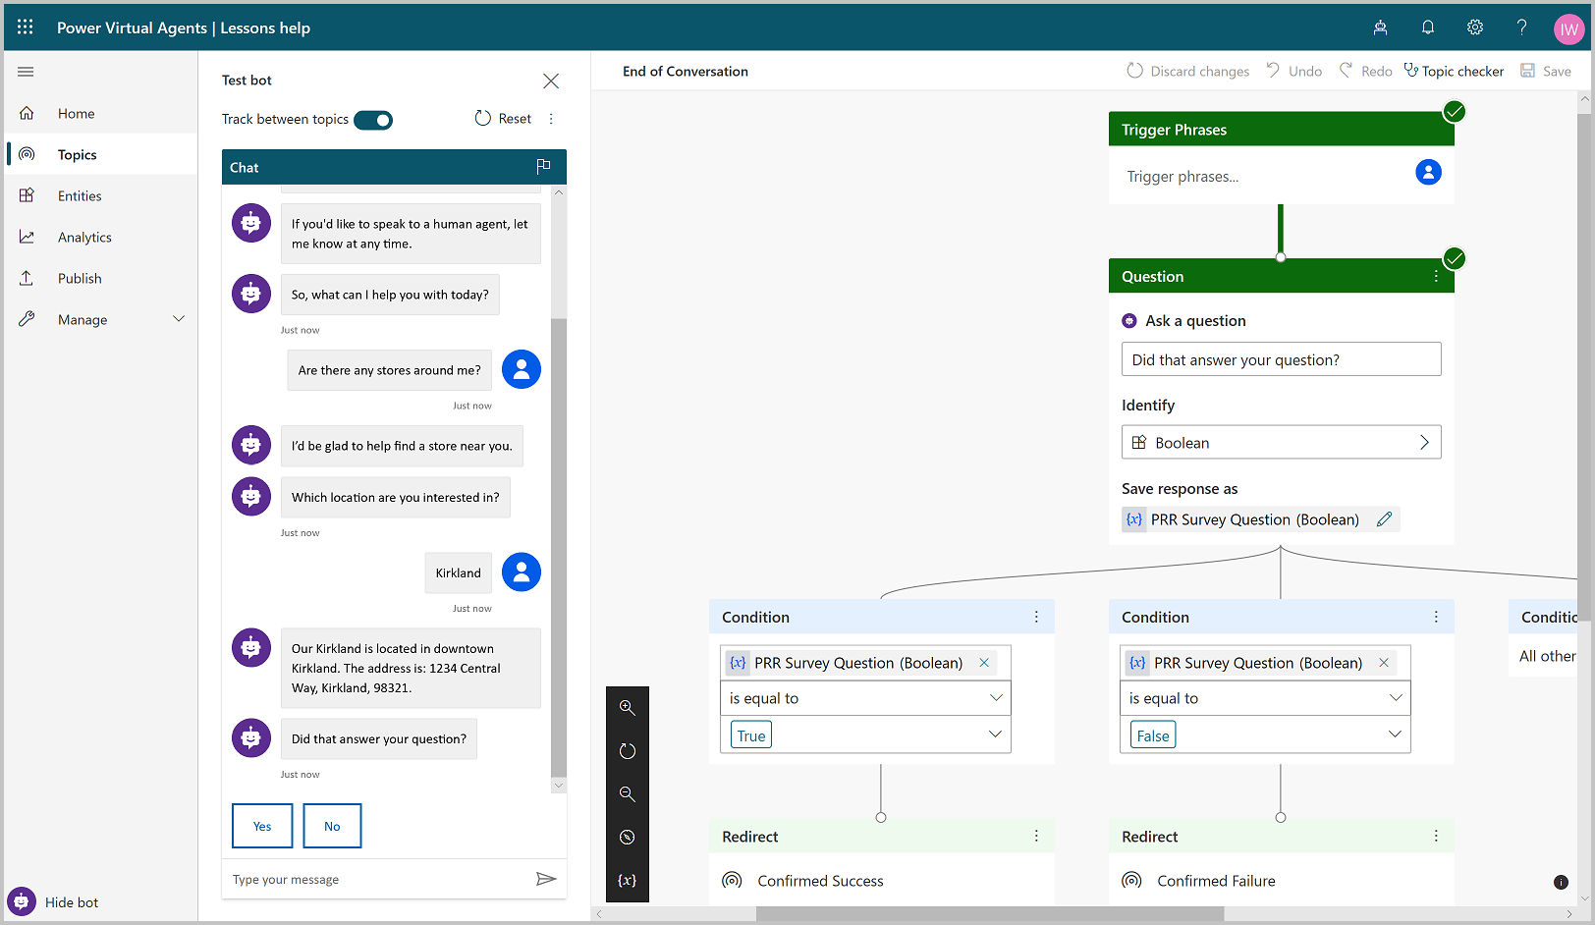
Power Virtual Agents

Slide 10

Get started with Power Apps
Introducing Power Apps
Power Apps building blocks
Power Apps related technologies
Ways to build Power Apps
Designing a Power Apps app
Demo-Create your first app

Slide 11
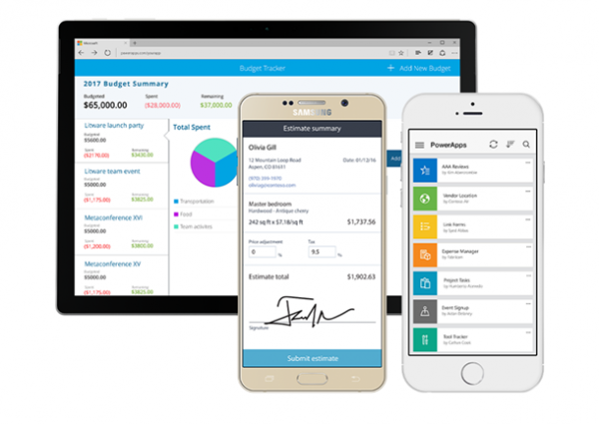
Introducing Power Apps
Apps built using Power Apps provide rich business logic and workflow capabilities to transform your manual business processes to digital, automated processes.

Slide 12
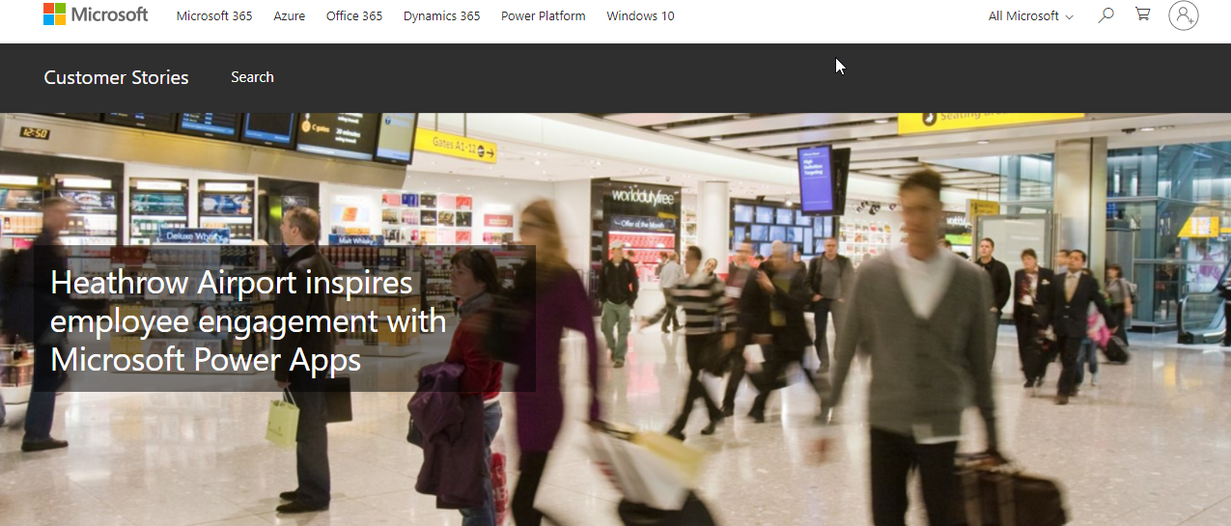
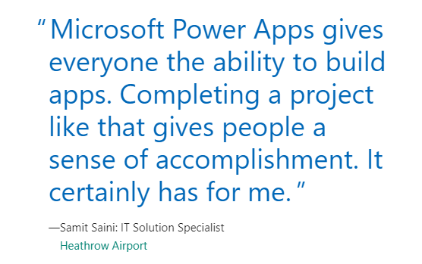
Real case scenario-Heathrow Airport

Slide 13
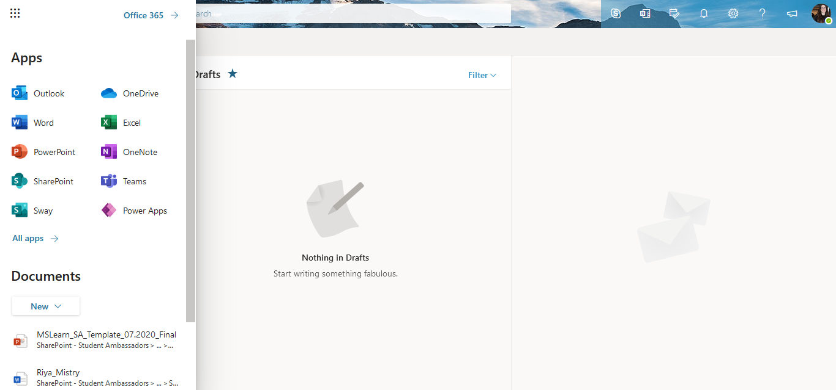
Finding Power Apps in your Office 365 subscription

Slide 14
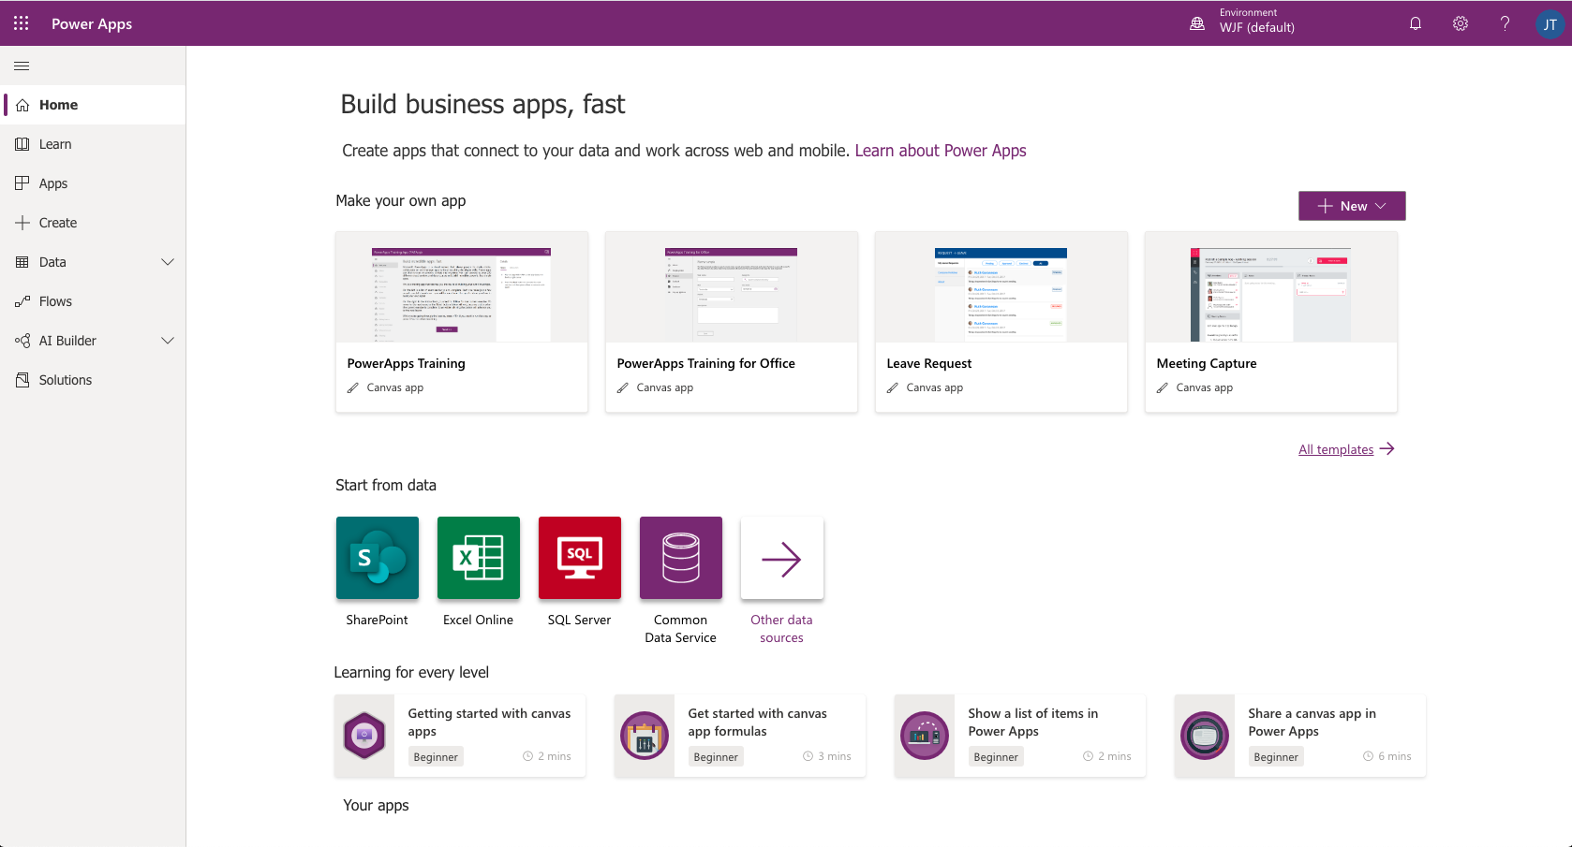
Power Apps Home Page

Slide 15
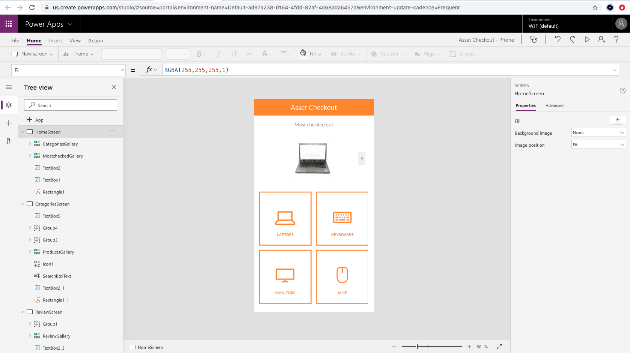
Power Apps Studio

Slide 16
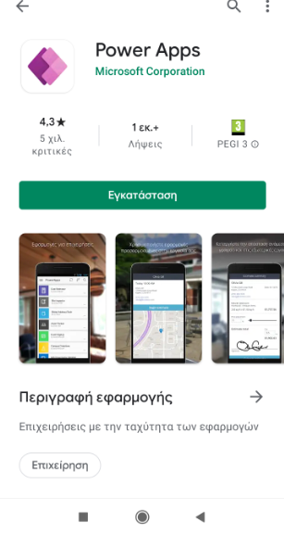
Power Apps Mobile

Slide 17
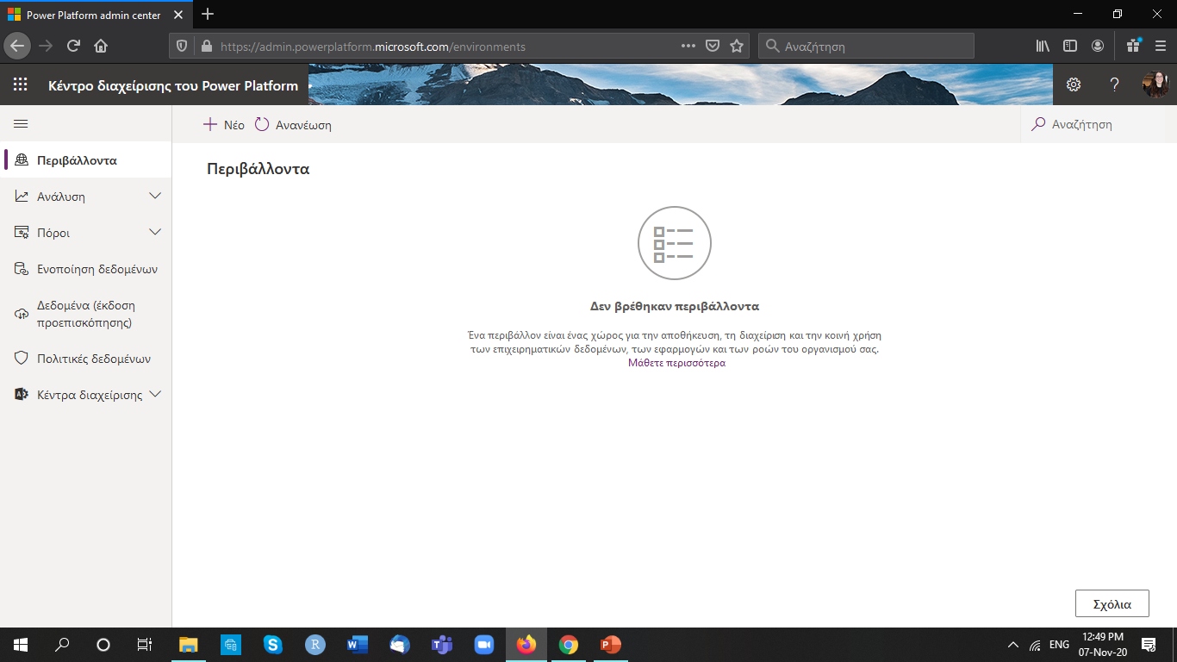
Power Platform Admin Center

Slide 18
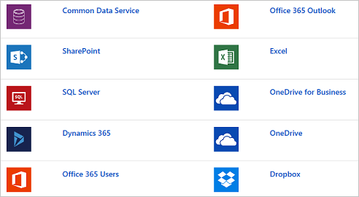
Data Sources

Slide 19
Licensing
Power Apps has more than 300 data source connectors available including Common Data Service. To incorporate Common Data Service or any of those additional connectors all users of the app will need a premium license. There are two different ways to acquire a Premium license:
Per App model
2. Per User model

Slide 20
Related Technologies
Power Apps
Power BI
Power Automate
Power Virtual Agents

Slide 21
Ways to build Power Apps
Create an app from template
Create an app from a data source
Build from a black canvas

Slide 22
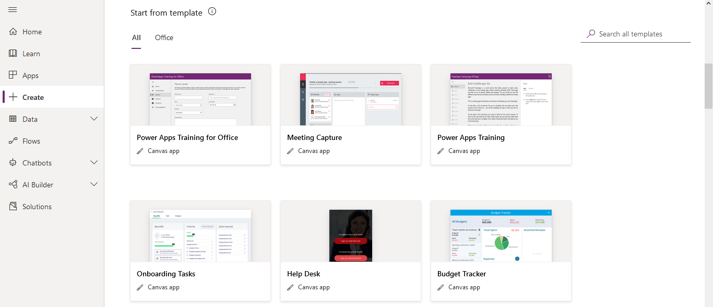
Create an app from template

Slide 23
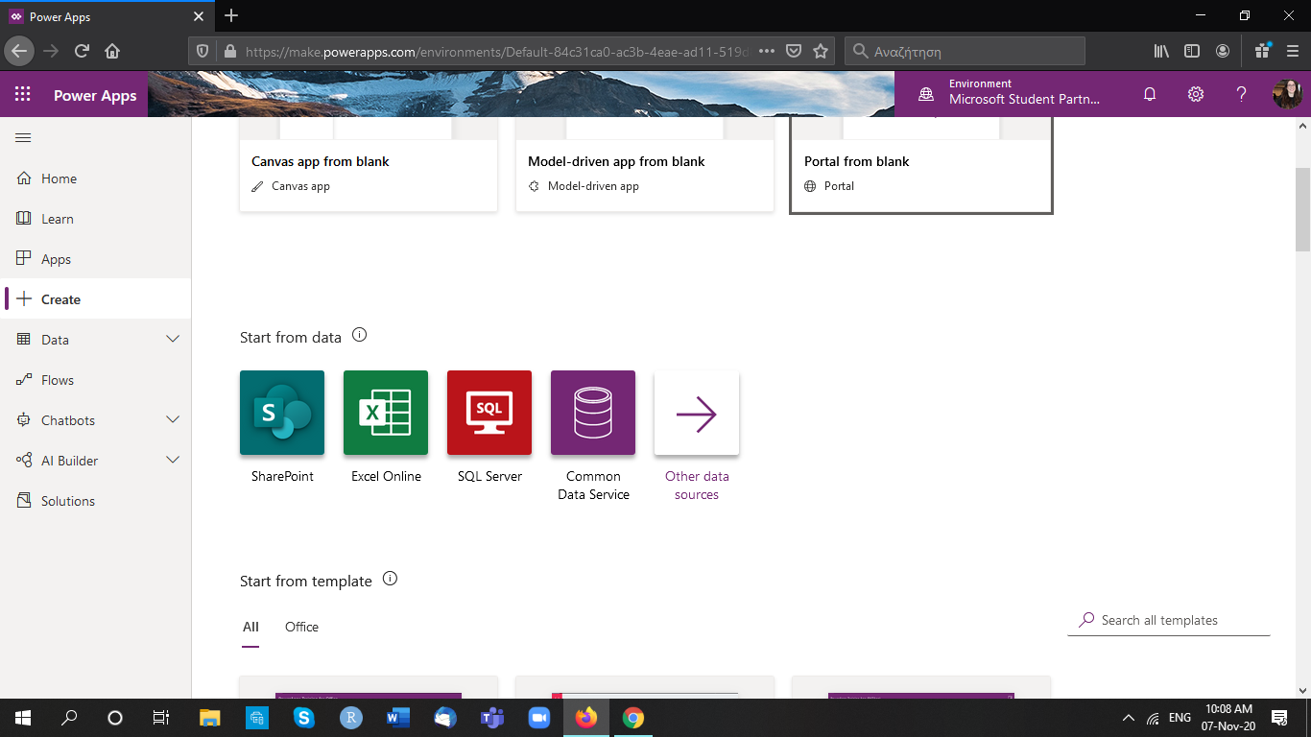
Create an app from a data source

Slide 24
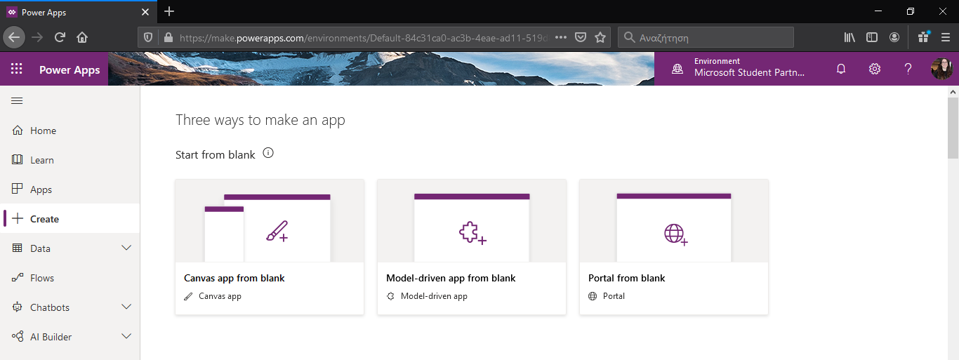
Build from a black canvas

Slide 25
Designing factors for consideration
Business Requirements
User Experience
Business Logic
User Interface
Data Model
Output

Slide 26

Short Demo-Create your first app in 5 minutes

Slide 27
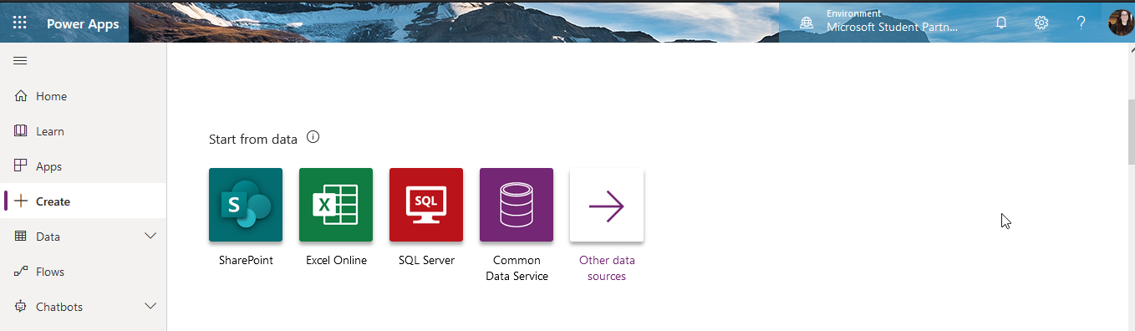
Create your first app in 5 minutes

Slide 28
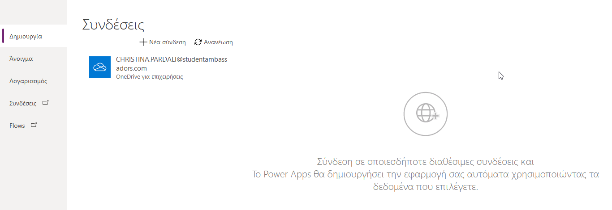
Create your first app in 5 minutes

Slide 29
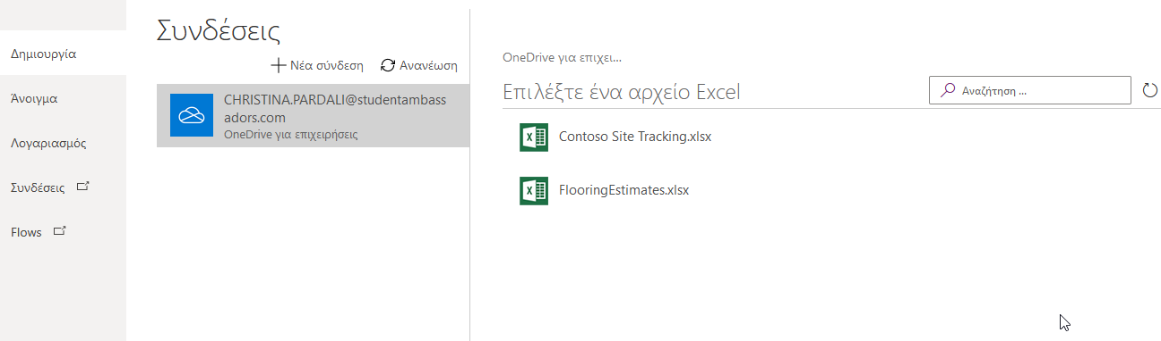
Create your first app in 5 minutes

Slide 30
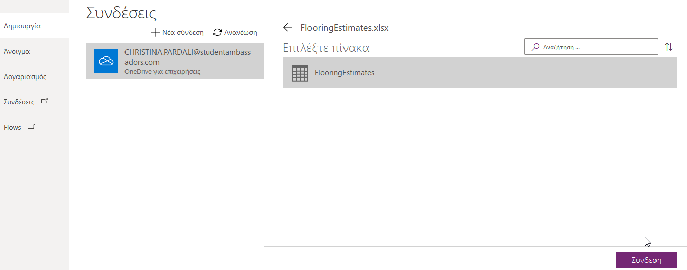
Create your first app in 5 minutes

Slide 31
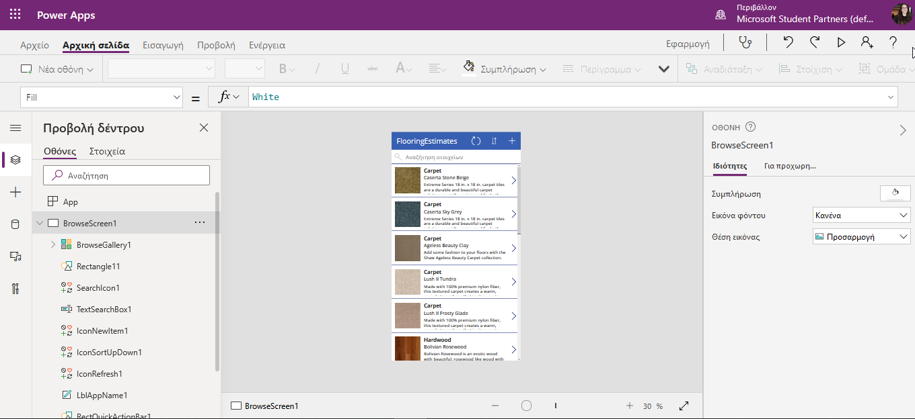
Create your first app in 5 minutes

Slide 32
2. Customize a canvas app in Power Apps
Improve apps by making basic customizations in Power Apps
Explore screens and controls in Power Apps
Get started with functions in Power Apps

Slide 33
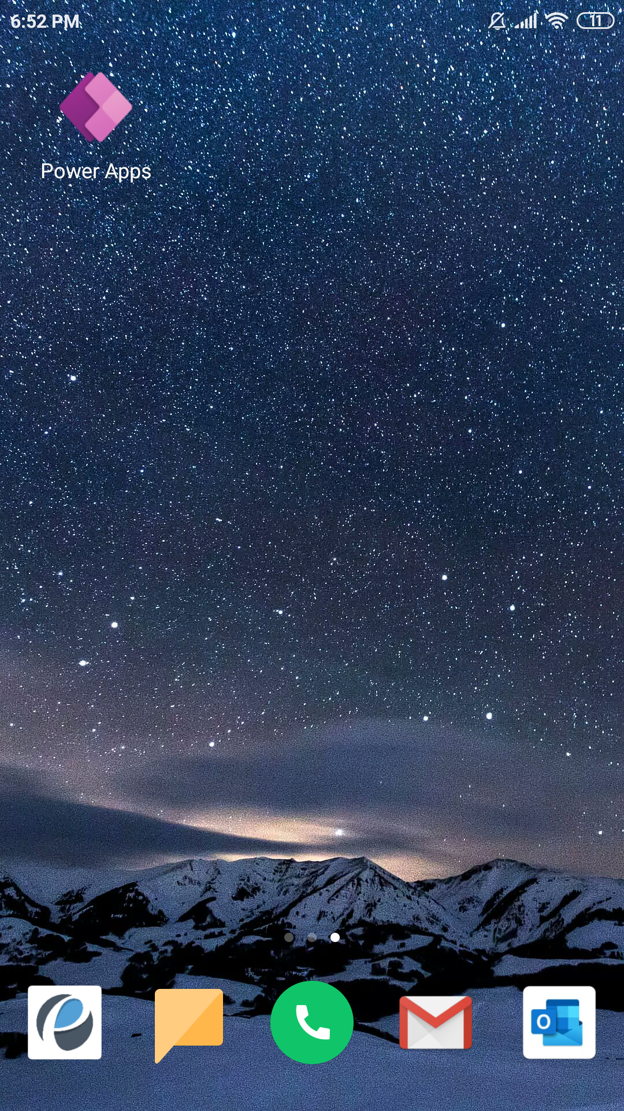
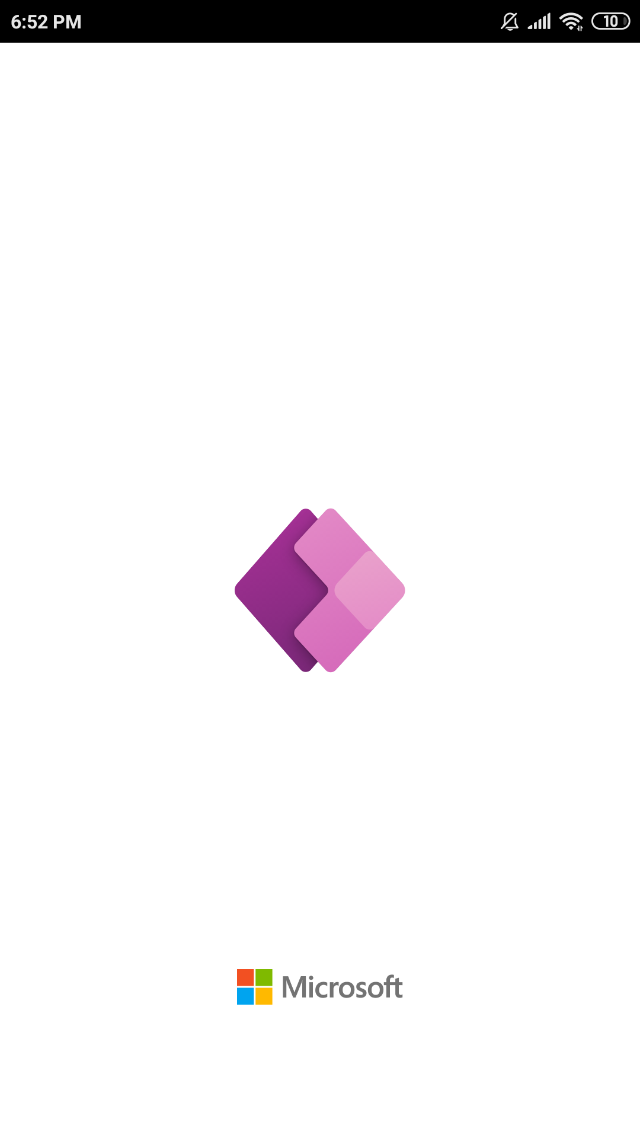
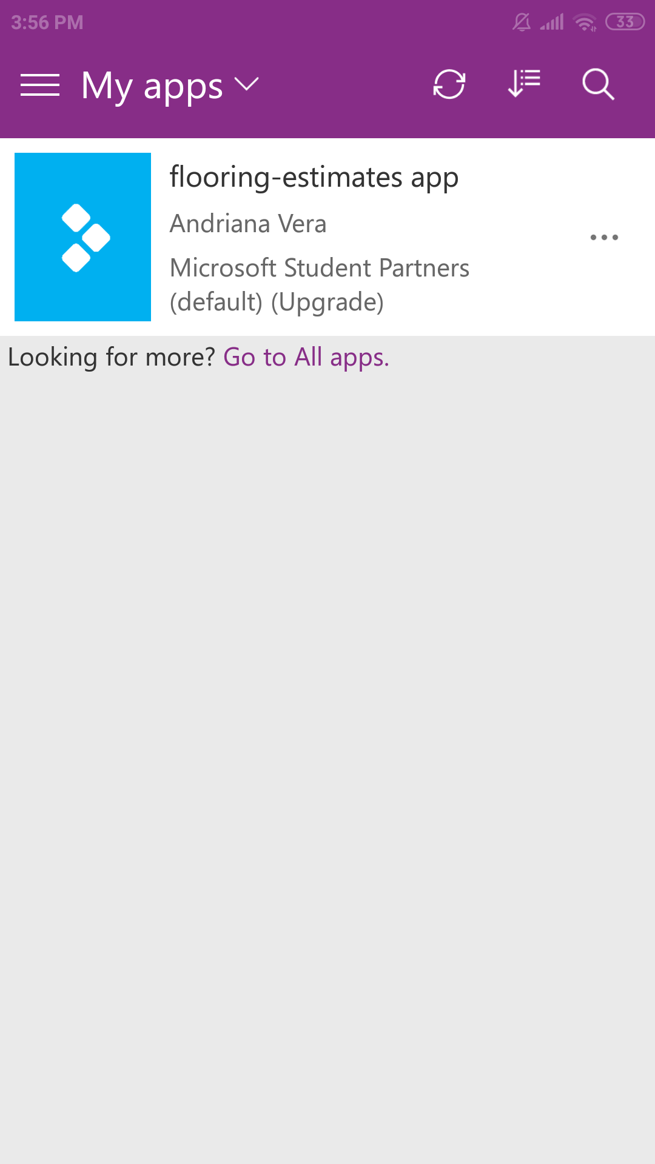
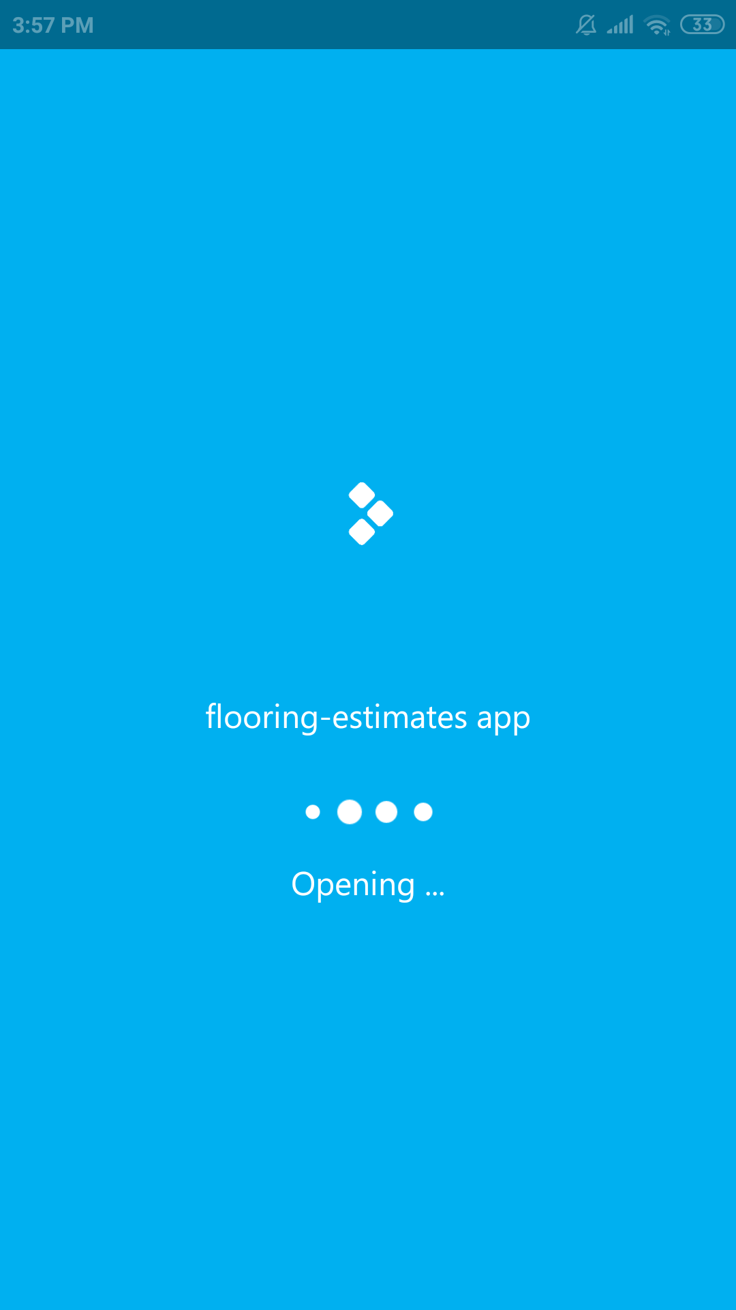
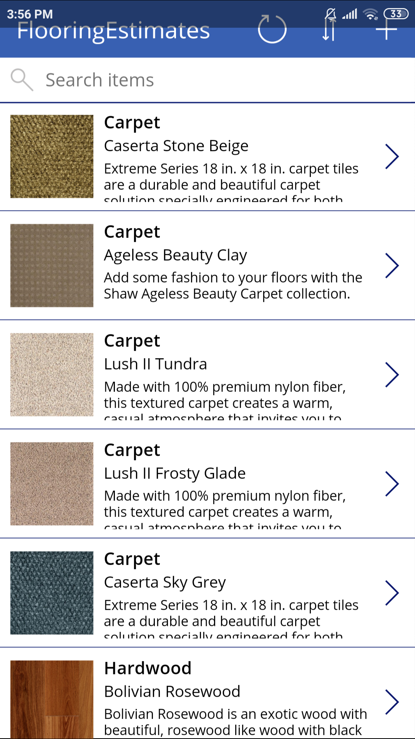
Our first app in mobile

Slide 34
3. Manage apps in Power Apps
Manage app versions in Power Apps
Share apps in Power Apps
Understand environments in Power Apps

Slide 35
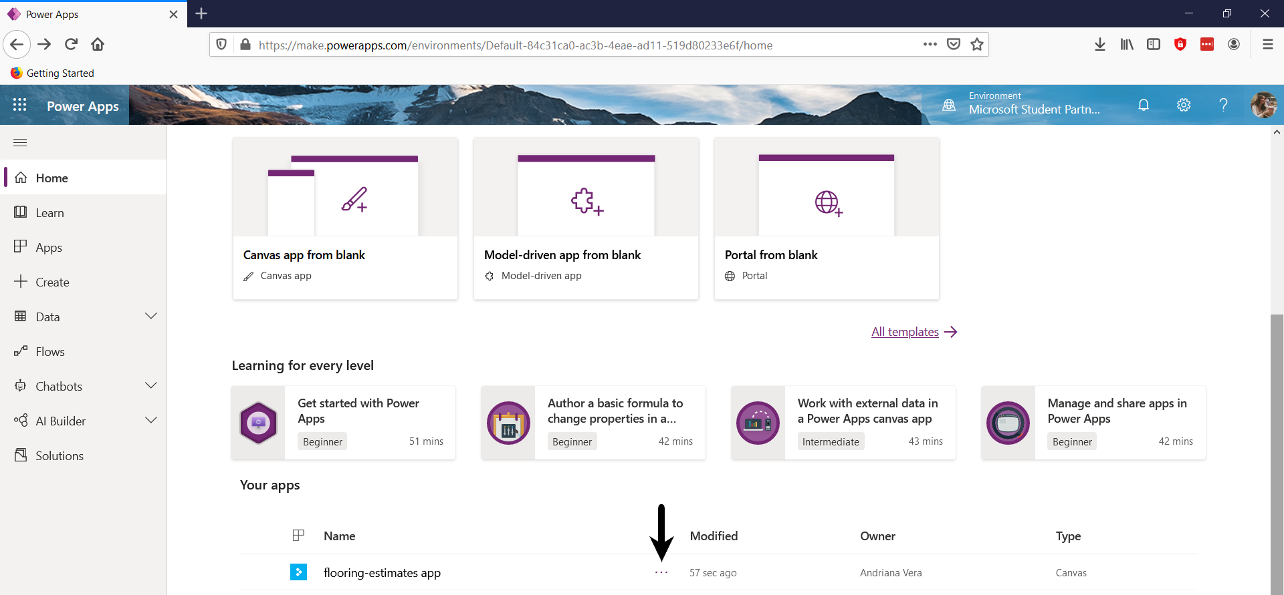
Manage an app

Slide 36
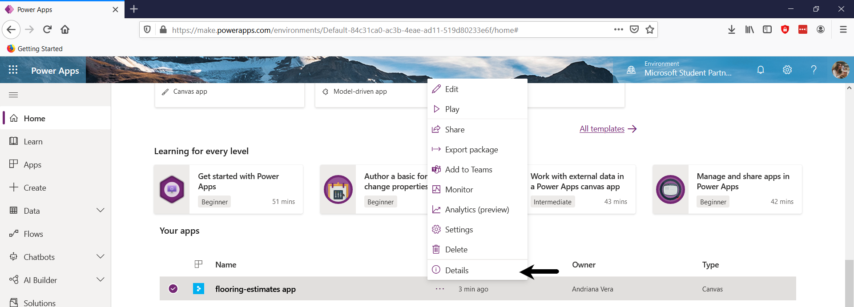
Manage an app

Slide 37
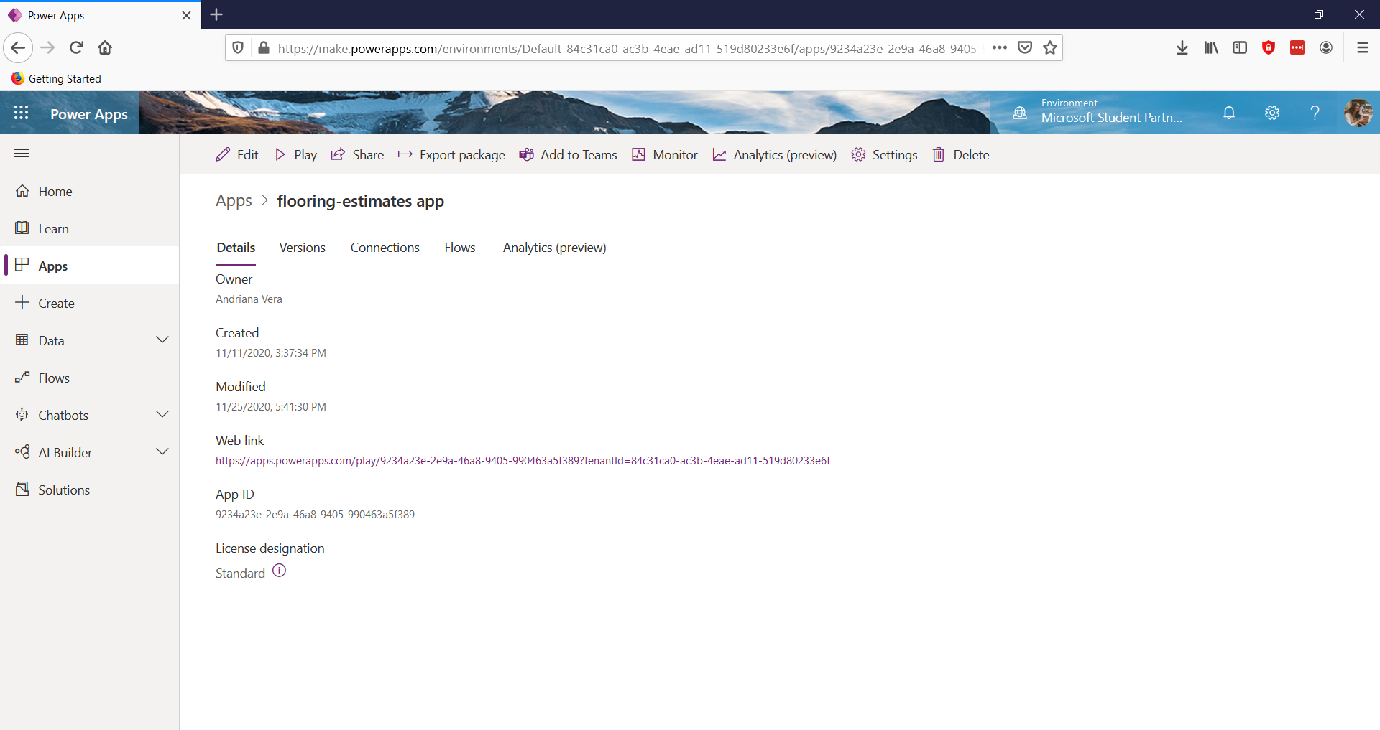
Manage an app

Slide 38
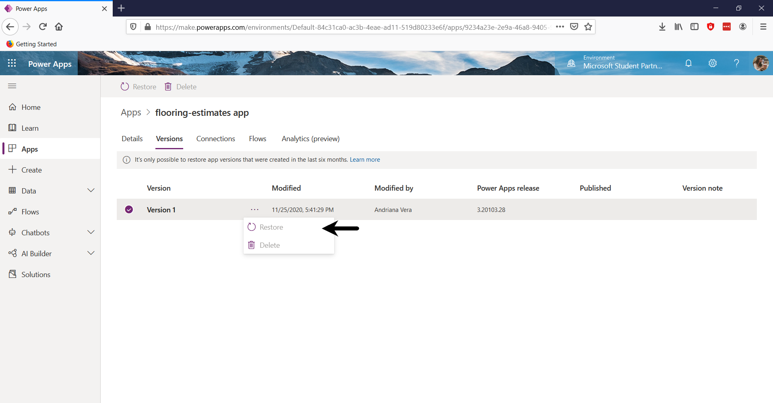
Manage an app

Slide 39
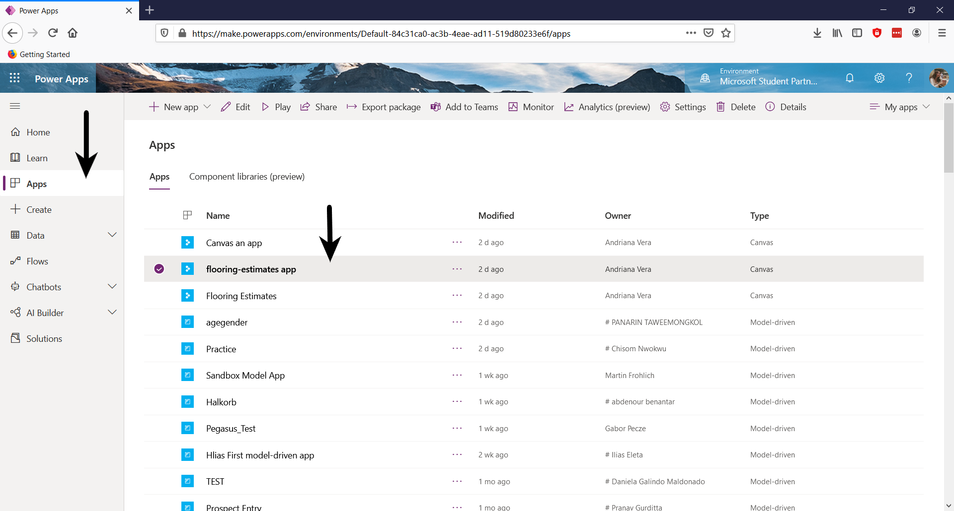
Share your app

Slide 40

Share your app

Slide 41
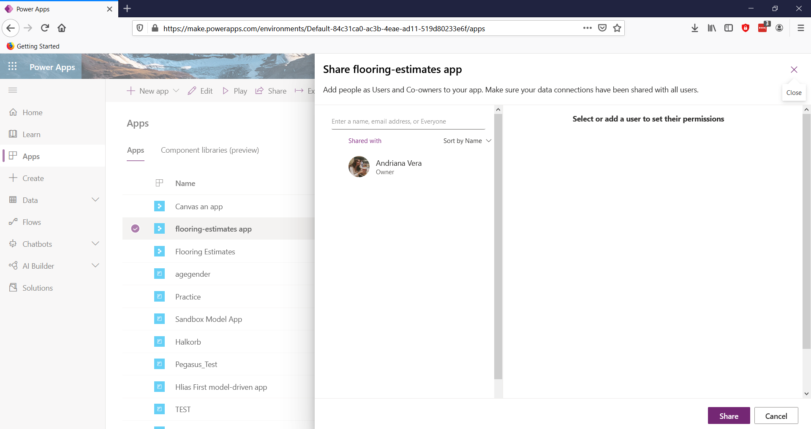
Share your app

Slide 42
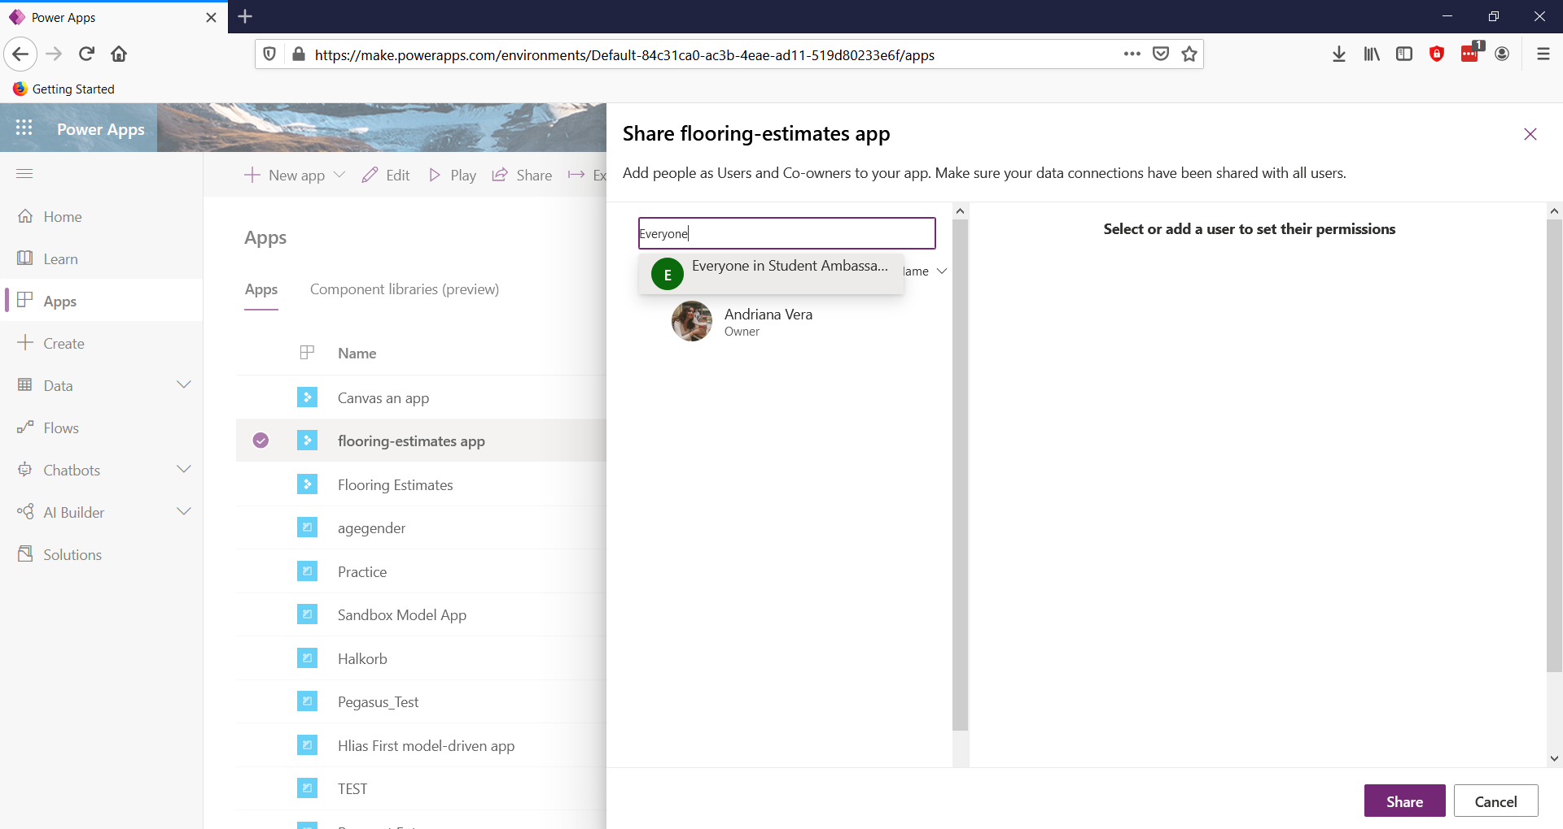
Share your app

Slide 43
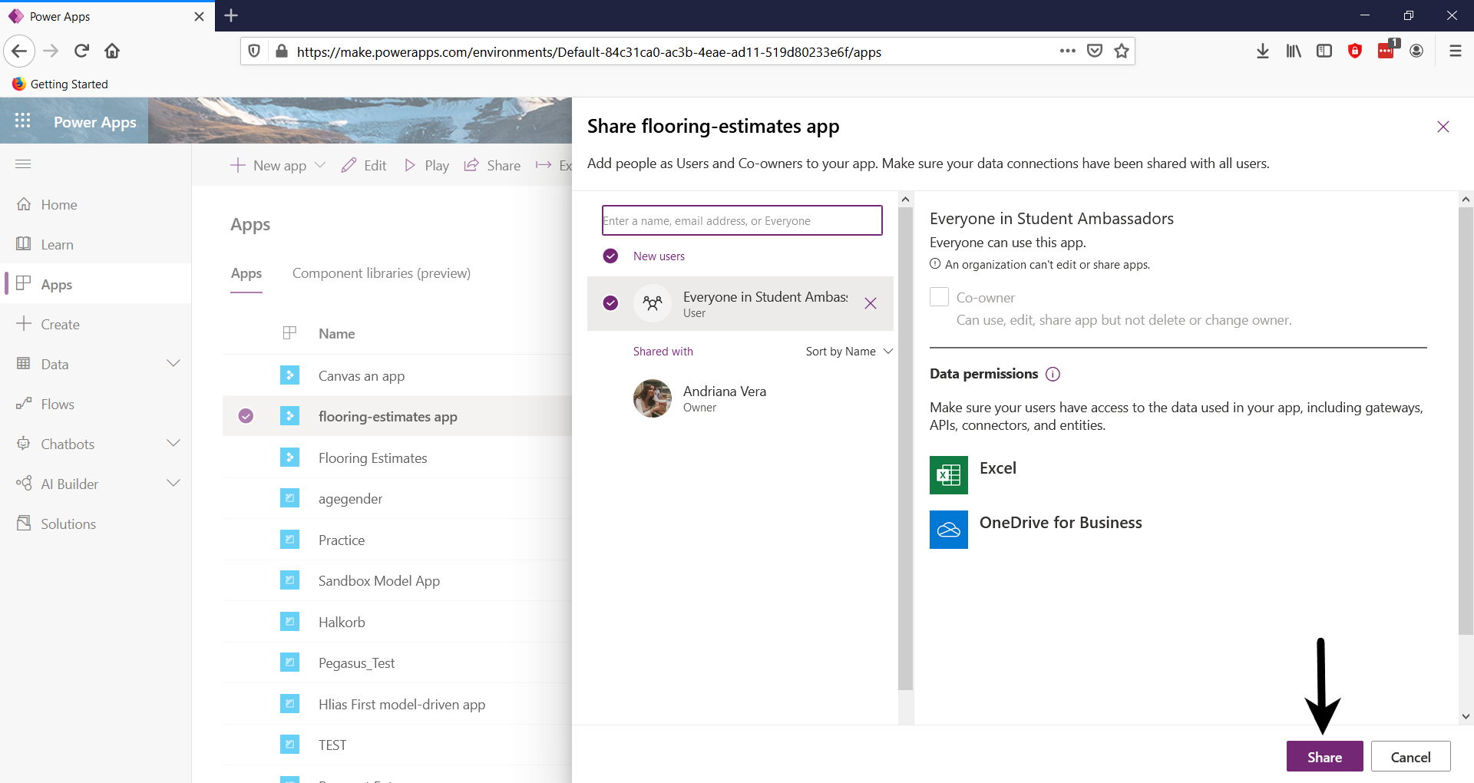
Share your app

Slide 44
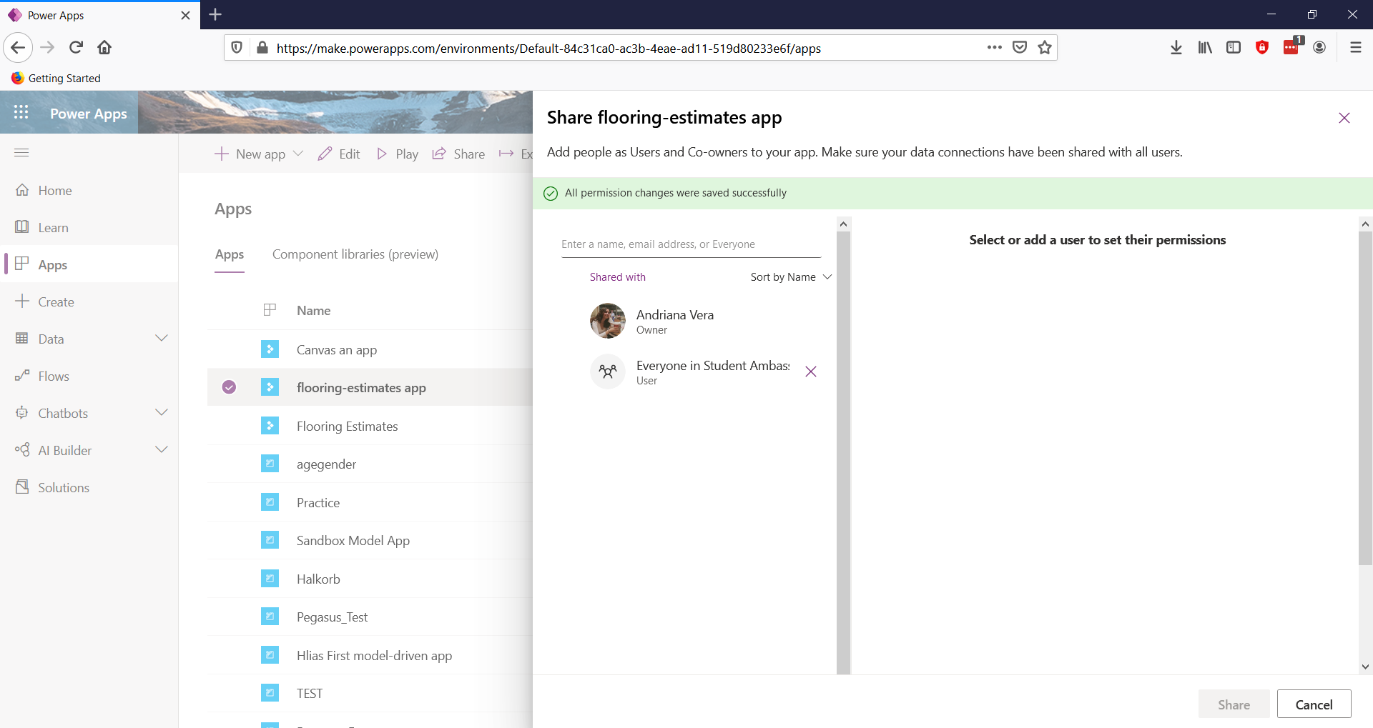
Share your app

Slide 45
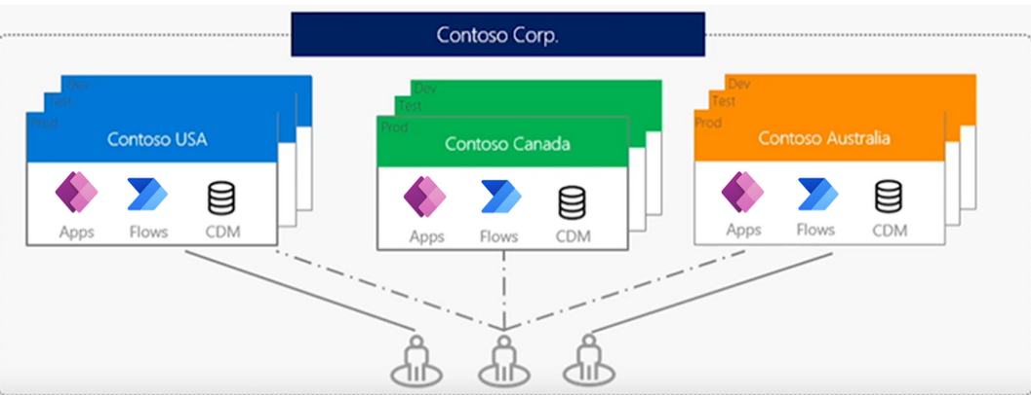
Environments in Power Apps

Slide 46
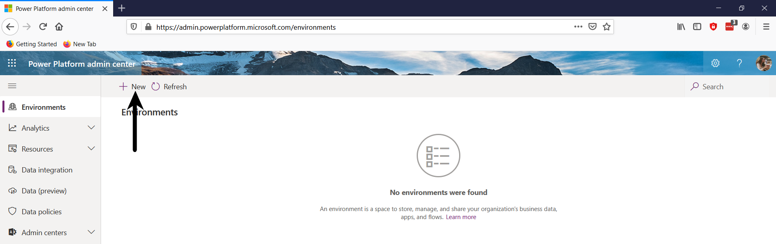
Create an environment

Slide 47
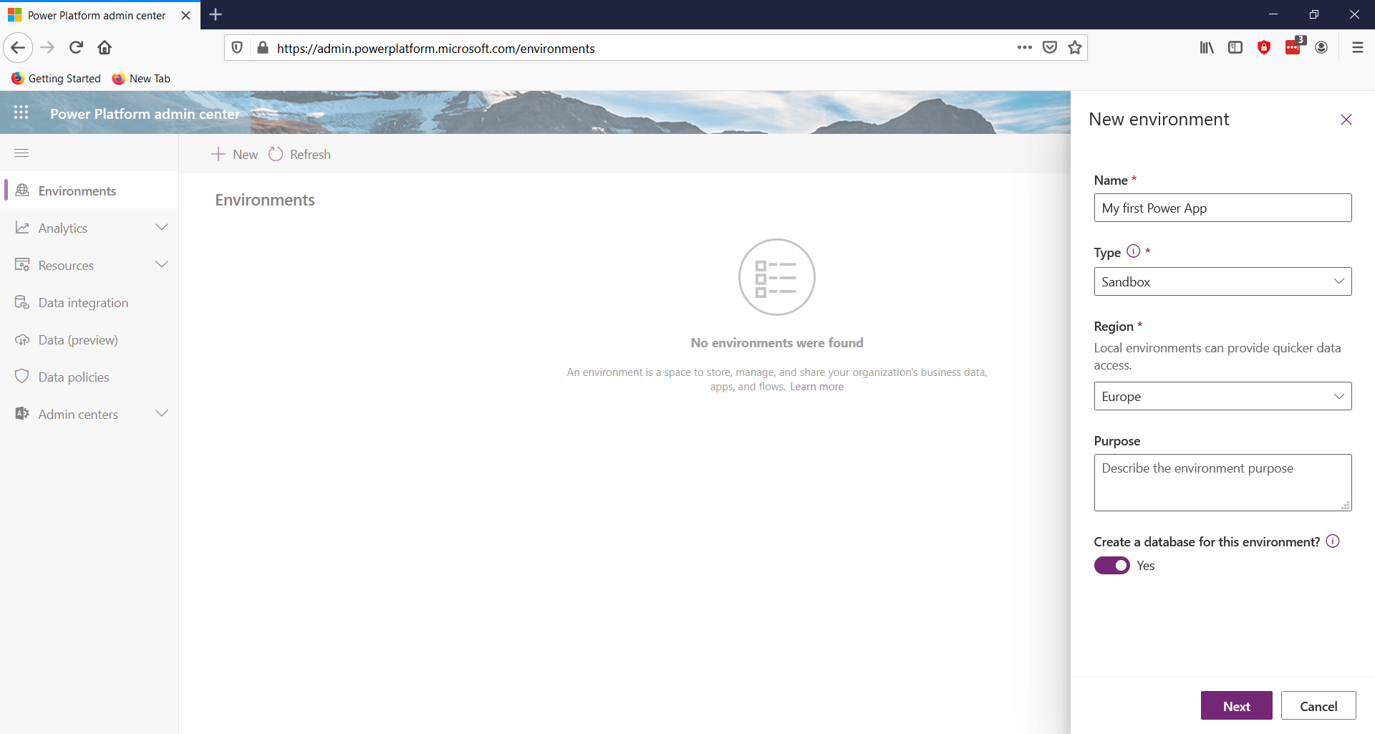
Create an environment

Slide 48
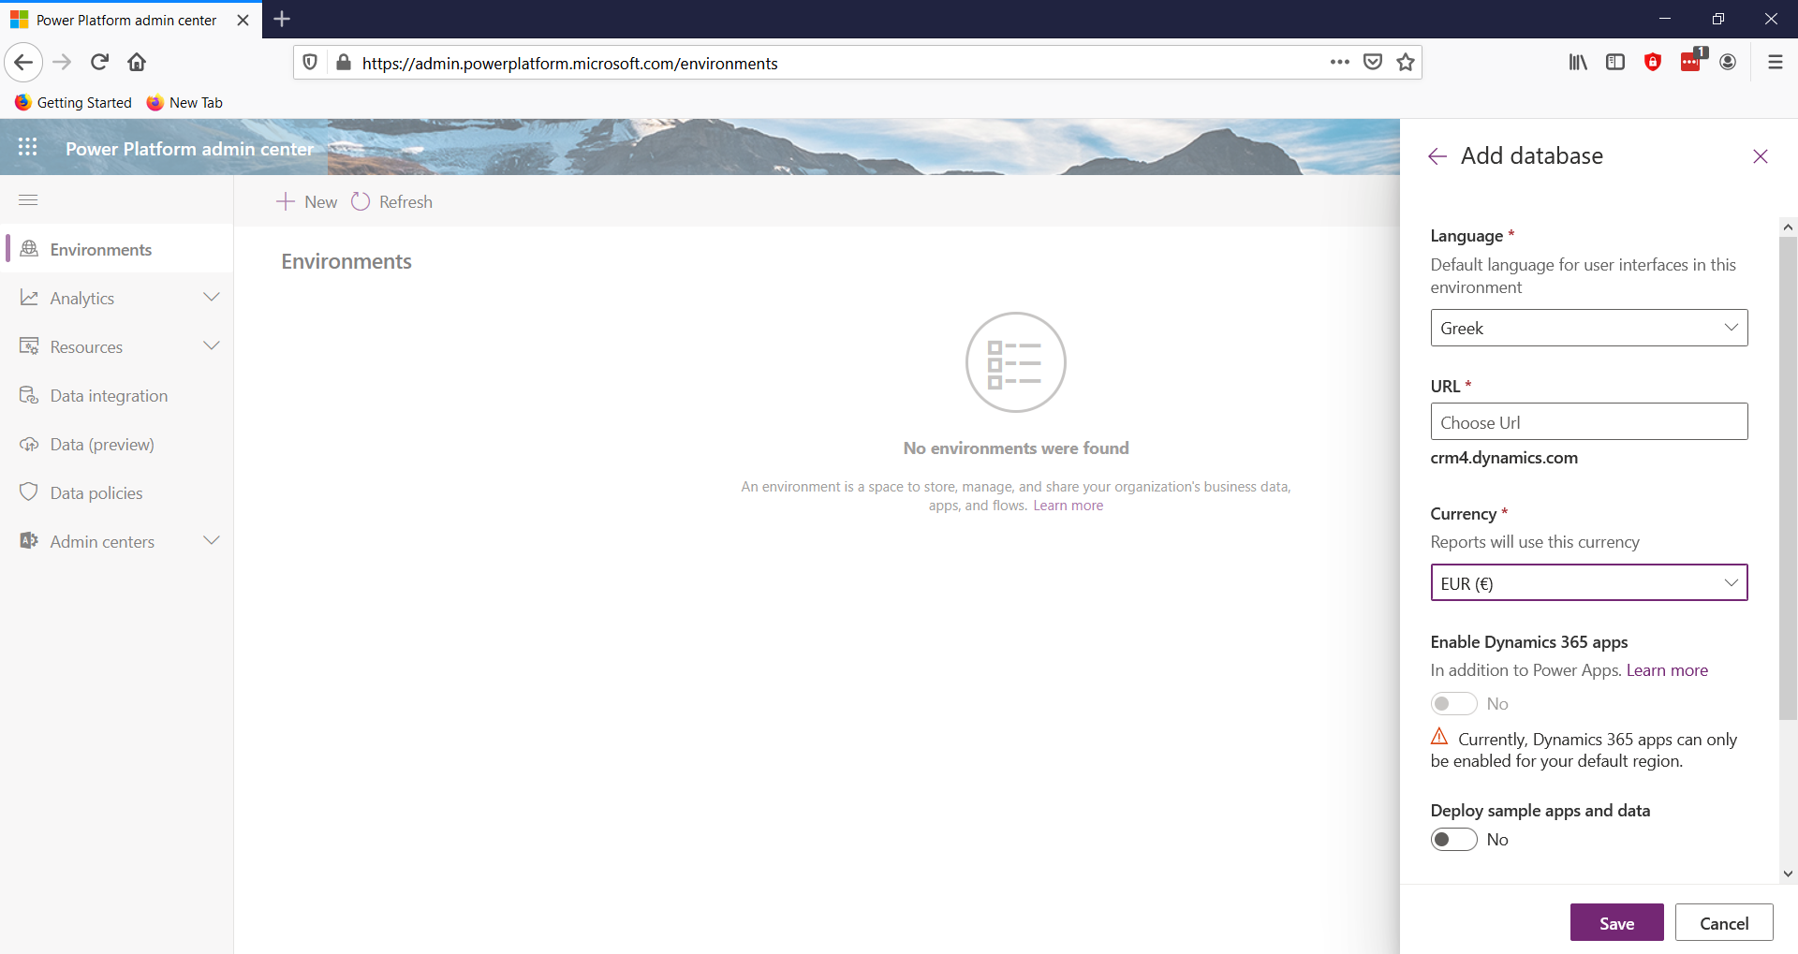
Create an environment

Slide 49
Resources on Power Platform:
https://docs.microsoft.com/en-ie/learn/paths/power-plat-fundamentals/
https://docs.microsoft.com/en-ie/learn/paths/create-powerapps/
https://powerapps.microsoft.com/el-gr/blog/

Slide 50
Emails
Andriana.Vera@studentambassadors.com
CHRISTINA.PARDALI@studentambassadors.com

Slide 51
Thank you!!

